Slide 1
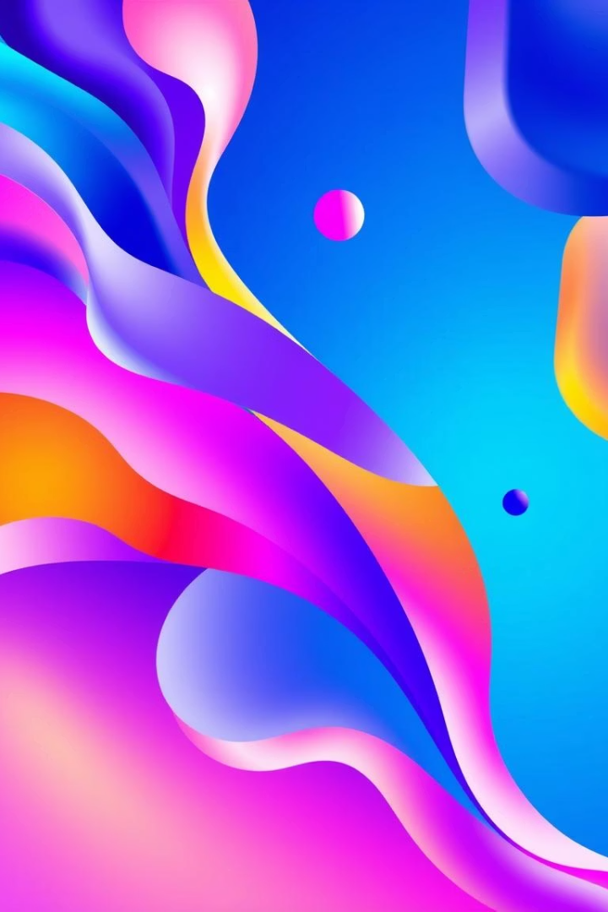
Mastering Modern CSS: A Developer's Guide
Welcome to this in-depth presentation on modern CSS techniques essential for every web developer. We'll explore fundamental concepts like positioning and responsive design, then delve into advanced topics such as CSS variables, transitions, and animations. Our goal is to provide clear explanations, practical examples, and actionable insights that you can immediately apply to your projects, making your web designs more dynamic, adaptable, and maintainable.

Slide 2
Understanding CSS Positioning
Static (Default)
Relative
Absolute
Fixed
Elements render in their natural order within the document flow. This is the default behavior for all HTML elements and provides the most predictable layout. You cannot use top, bottom, left, or right properties with static positioning.
Elements are positioned relative to their normal position. Using top, bottom, left, or right will shift the element from its original place, but it still occupies that space in the document flow, affecting subsequent elements.
Elements are positioned relative to their closest positioned ancestor. If no ancestor is positioned, they are relative to the initial containing block (usually the document body). Absolutely positioned elements are removed from the normal document flow.
Elements are positioned relative to the viewport, meaning they stay in the same place even if the page is scrolled. Useful for navigation bars or "back to top" buttons that need to remain visible.
.navbar { position: fixed; top: 0; width: 100%;}
.button { position: relative; top: 10px; left: 20px;}
.element { position: static;}
.tooltip { position: absolute; top: 0; right: 0;}
Think of CSS positioning like arranging items on a shelf. Static is the default placement, relative lets you nudge an item from its spot, absolute allows you to float an item relative to a specific box (like a parent container), and fixed keeps an item stuck to the camera view, no matter how much you move the shelf.

Slide 3




Building for Every Screen: Responsive Design
Mobile-First Approach
Flexible Grids & Images
Start designing for the smallest screen size first, then progressively enhance for larger screens. This forces you to prioritize content and performance, leading to a better user experience on all devices.
Use percentages, EMs, REMs, and viewport units (vw, vh) instead of fixed pixel widths for layout elements. Ensure images scale proportionally to avoid overflow using max-width: 100%.
Media Queries
Accessibility Considerations
Apply specific CSS rules based on device characteristics like screen width, height, or orientation. This allows for tailored layouts and styles at different breakpoints, ensuring optimal display.
Ensure your responsive design remains accessible across devices. Focus on readable font sizes, sufficient contrast, and proper navigation for touch and keyboard users, avoiding tiny interactive elements.
@media (max-width: 768px) { .container { flex-direction: column; }}
Responsive design is like a chameleon, adapting its appearance to any environment. Just as a chameleon changes color to blend in, your website should adjust its layout and elements to fit any screen size, from a tiny smartphone to a large desktop monitor. This ensures a consistent and enjoyable experience for all users.

Slide 4
Dynamic Styling with CSS Variables
Defining Variables
Using Variables
Real-World Example: Theming
CSS variables, also known as custom properties, are defined using a double hyphen prefix (e.g., --primary-color). They are case-sensitive and can be defined at the global level (:root) or within specific selectors, allowing for scoped variables.
To use a CSS variable, you employ the var() function, passing the variable name as an argument. This function can also accept a fallback value, which is used if the variable is not defined, enhancing robustness.
Imagine you have a website with a light and dark theme. Instead of writing separate CSS for each, define theme colors as variables. When a user switches themes, simply update the variable values in the :root scope. This instantly applies the new theme across your entire site, saving time and code.
:root { --primary-color: #007bff; --font-size-base: 16px;}
.button { background-color: var(--primary-color); font-size: var(--font-size-base);}
body.light-theme { --text-color: #333; --bg-color: #fff;}body.dark-theme { --text-color: #fff; --bg-color: #333;}
CSS variables are like smart paint buckets for your website. Instead of having to manually change the color of every wall, you simply change the color in your "color variable" bucket, and all the walls painted with that bucket instantly update. This makes global style changes, like switching themes, incredibly efficient and easy to manage.

Slide 5
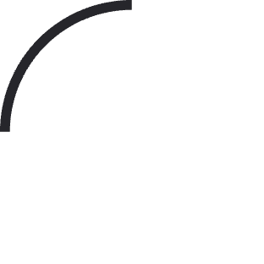
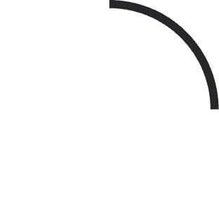

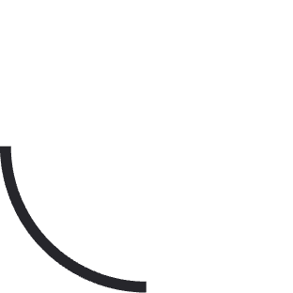
Bringing Designs to Life with CSS Animations
Keyframes
Animation Properties
Animations are built using @keyframes, which define specific styles at different stages of the animation (e.g., 0%, 50%, 100%). This allows for complex sequences of changes.
Properties like animation-name, animation-duration, animation-iteration-count (how many times it runs), animation-direction, and animation-fill-mode (what happens after it finishes) control how the keyframes play out.
@keyframes slide-in { from { opacity: 0; transform: translateX(-100%); } to { opacity: 1; transform: translateX(0); }}
.element { animation: slide-in 1s ease-out forwards;}
Example: Traffic Light
Infinite Loops
Consider a traffic light. An animation would be the sequence of green, yellow, and red lights changing in a specific order and duration, repeating continuously. This structured, timed sequence is exactly what CSS animations allow you to create.
Set animation-iteration-count: infinite; to create continuous animations, perfect for loading spinners or background effects. Be mindful of performance and user experience with repetitive animations.
CSS animations are like choreographing a dance for your website elements. You define the precise movements and timing of each step (keyframes), and then tell the element how to perform the dance (animation properties). This allows for complex, multi-stage visual effects that can play once or loop endlessly, bringing your design to life beyond simple transitions.

